Slide 1


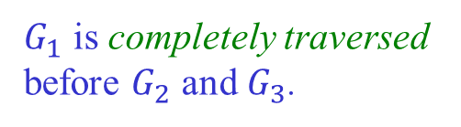


Depth-First Search
Idea: Keep going forward as long as there are unseen nodes
to be visited. Backtrack when stuck.
$G_{1}$ is completely traversed
before $G_{2}$ and $G_{3}$.
$$v$$
$$G_{3}$$
$$G_{1}$$
$$G_{2}$$

Slide 2


Color Map & Predecessor
Just like in BFS:
♦ color($v$) == green: $v$ is undiscovered and unprocessed
♦ color($v$) == red: $v$ has been discovered but not processed
♦ color($v$) == black: $v$ has been discovered and processed
pred($v$): predecessor of $v$ in the search.

Slide 3
The DFS Algorithm
dfs(G):
foreach node v in G
color(v) = green
pred(v) = null
foreach node v in G
if color(v) == green
dfsVisit(G, v, color, pred)
return pred
dfsVisit(G, u, color, pred):
color(u) = red
foreach neighbor v of u
if color(v) == green
pred(v) = u
dfsVisit(G, v, color, pred)
color(u) = black

Slide 4












A DFS Example
time = 1
(time at which a node is visited)
8
9
$$a$$
$$h$$
$$i$$
4
$$c$$
$$d$$
$$e$$
6
7
10
$$j$$
5
$$g$$
$$b$$
$$k$$
$$l$$
$$f$$
11
12
2
3

Slide 5












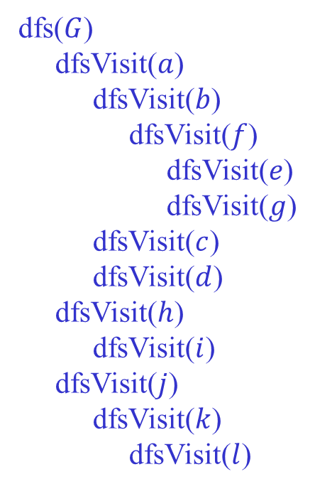
Recursive DFS Calls
1
dfs($G$)
dfsVisit($a$)
dfsVisit($b$)
dfsVisit($f$)
dfsVisit($e$)
dfsVisit($g$)
dfsVisit($c$)
dfsVisit($d$)
dfsVisit($h$)
dfsVisit($i$)
dfsVisit($j$)
dfsVisit($k$)
dfsVisit($l$)
$$a$$
$$c$$
$$d$$
$$e$$
4
6
7
5
$$g$$
2
3
$$b$$
$$f$$
8
9
$$h$$
$$i$$
10
$$j$$
$$k$$
$$l$$
dfsVisit(v) explores every unvisited vertex
reachable from v before it returns.
11
12

Slide 6





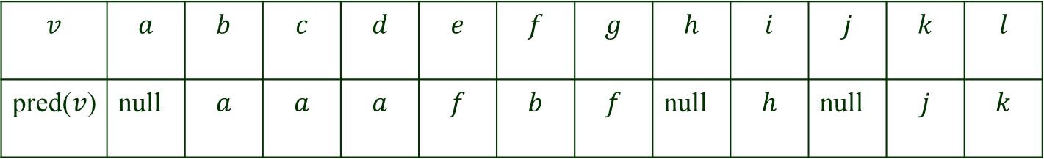
Predecessor Table
$$a$$
$$c$$
$$d$$
$$e$$
$$j$$
$$h$$
$$i$$
$$k$$
$$l$$
$$g$$
$$b$$
$$f$$
$$v$$ | $$a$$ | $$b$$ | $$c$$ | $$d$$ | $$e$$ | $$f$$ | $$g$$ | $$h$$ | $$i$$ | $$j$$ | $$k$$ | $$l$$
pred($v$) | null | $$a$$ | $$a$$ | $$a$$ | $$f$$ | $$b$$ | $$f$$ | null | $$h$$ | null | $$j$$ | $$k$$

Slide 7











Depth-First Search Forest
$$a$$
$$h$$
$$i$$
$$c$$
$$d$$
$$e$$
$$j$$
$$g$$
$$k$$
$$l$$
$$b$$
f
Edges that, during DFS, lead to an unexplored vertex form a depth-first
search forest.
The DFS forest can be constructed from the predecessor table.

Slide 8






DFS on a Directed Graph
$$a$$
$$e$$
$$b$$
$$c$$
$$f$$
$$g$$
$$d$$

Slide 9





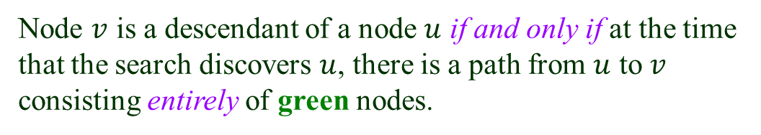


The Green-Path Theorem
♦ color($v$) == green: $v$ is undiscovered and unprocessed
DFS forest of a (directed or undirected) graph $G:$
Node $v$ is a descendant of a node $u$ if and only if at the time
that the search discovers $u$, there is a path from $u$ to $v$
consisting entirely of green nodes.
$$s$$
$$u$$
$v$ will be discovered after $u$
and before DFS backtracks to $u$.
green path
$$v$$
$v$ is in the DFS subtree rooted at $u$.

Slide 10


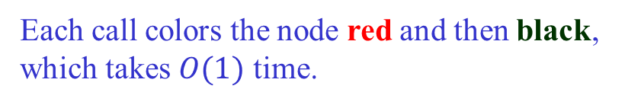

Running Time of DFS
$(|V| + |E|)$ if we use an adjacency list or HashMap/HashSet.
dfsVisit is called exactly once for each node.
$|V|$such calls in total.
Each call colors the node red and then black,
which takes $O(1)$ time.
Each edge is examined $O(1)$ time.
$(|V|^{2})$ if we use an adjacency matrix.

Slide 11












Edge Classification – Undirected Graphs
1. Tree edges are those in the DFS forest.
2. Back edges go from a vertex to one of its ancestors.
$$a$$
$$h$$
$$j$$
$$b$$
$$c$$
$$d$$
$$i$$
$$k$$
$$f$$
$$l$$
$$g$$
$$e$$
This DFS forest consists of three DFS trees.

Slide 12





Edge Classification – Directed Graphs
Besides tree edges and back edges, there are also
3. Forward edges go from a vertex to one of its descendants.
4. Cross edges: all other edges.
$$a$$
$$b$$
$$d$$
$$h$$
$$g$$
$$c$$
$$e$$
$$i$$
If all the edges were undirected, forward and cross edges would be either
tree or back edges.

Slide 13









How to Tell Them Apart?
Tree edges lead to green (new) nodes and form DFS trees.
$$a$$
DFS tree 1
$$b$$
$$d$$
$$h$$
DFS tree 2
$$g$$
$$c$$
$$e$$
$$i$$
Add every other edge separately to the DFS forest.
Back edges connect nodes in the same DFS tree.
♦ back edge: descendent $→$ ancestor

Slide 14









Forward Edge
Forward edges also connect nodes in the same DFS tree.
♦ forward edge: ancestor $→$ descendent
$$a$$
$$b$$
$$d$$
$$h$$
$$g$$
$$c$$
$$e$$
$$i$$

Slide 15
















Cross Edge
Each cross edge is one of two cases:
♦ Its two vertices are in the same DFS tree but not related.
$$a$$
$$b$$
$$d$$
$$h$$
$$g$$
$$c$$
$$e$$
$$i$$
♦ They are in different DSF trees.
$$a$$
$$b$$
$$d$$
$$h$$
$$g$$
$$c$$
$$e$$
$$i$$

Slide 16
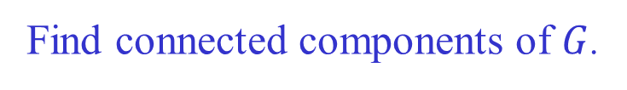

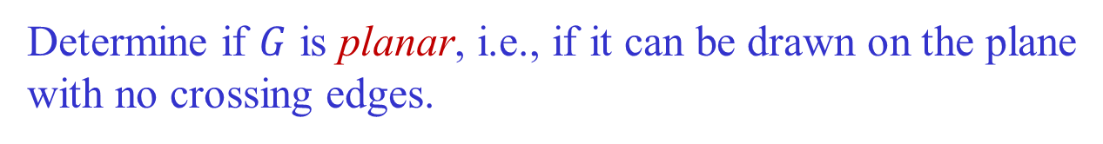

Applications of DFS
In $O(|V| + |E|)$time, we can
Find connected components of $G$.
Determine if $G$ has a cycle.
Determine if removing a vertex or edge will disconnect $G$.
Determine if $G$ is planar, i.e., if it can be drawn on the plane
with no crossing edges.
…

Slide 17
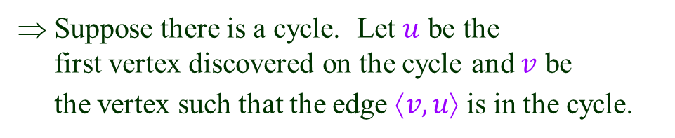
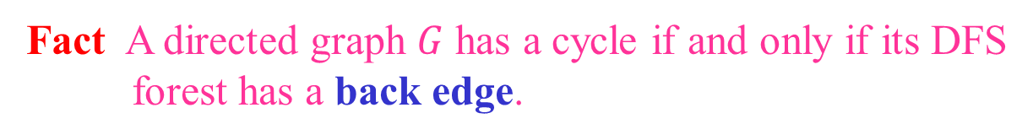
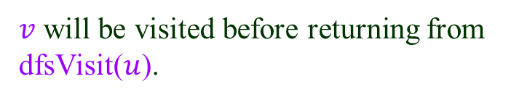
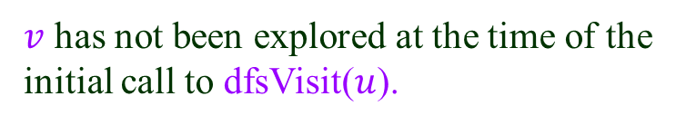
Detecting Cycles
Fact A directed graph $G$ has a cycle if and only if its DFS
forest has a back edge.
a
⇐ A back edge leads to a cycle (adding an
edge to a tree).
b
⇒ Suppose there is a cycle. Let $u$ be the
first vertex discovered on the cycle and $v$ be
the vertex such that the edge $↑v, u$ is in the cycle.
c
$v$ has not been explored at the time of the
initial call to dfsVisit($u$).
v
$v$ will be visited before returning from
dfsVisit($u$).
u
Therefore at the time of visiting $v$, a back edge ⟨$v, u$⟩ will be found.
The fact also holds for an undirected graph.

Slide 18
Using DFS
A back edge can be easily detected during DFS.
root
u
v
We can test if a graph is acyclic in $O(|V|+|E|)$time.

Slide 19
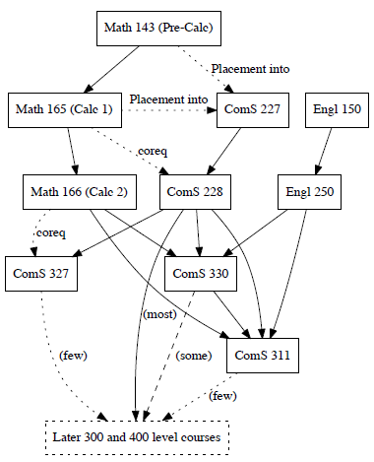
Directed Acyclic Graph (DAG)
Model precedences among events.
Com S course flowchart:
How to plan courses?

Slide 20



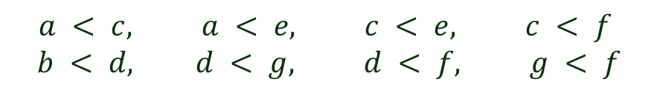



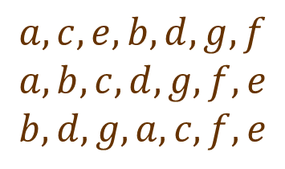


Topological Sort of DAGs
Ordering $<$ over $vertices: u<v$ whenever $↑u, v$ is an edge.
$$a$$
$$b$$
Some topological sorts:
$$a, c, e, b, d, g, f$$
$$a, b, c, d, g, f, e$$
$$b, d, g, a, c, f, e$$
$$c$$
$$d$$
$$e$$
$$f$$
$$g$$
How about $b, a, d, c, e, f, g$?
order violation
$$a < c, a < e, c < e, c < f$$
$$b < d, d < g, d < f, g < f$$

Slide 21
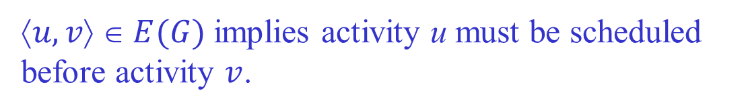
Intuition: Precedence Diagram
Each node represents an activity; e.g., taking a class.
$↑u, v$ $ E(G)$implies activity u must be scheduled
before activity $v$.
Topological sort schedules all activities.
More than one schedule may exist.

Slide 22
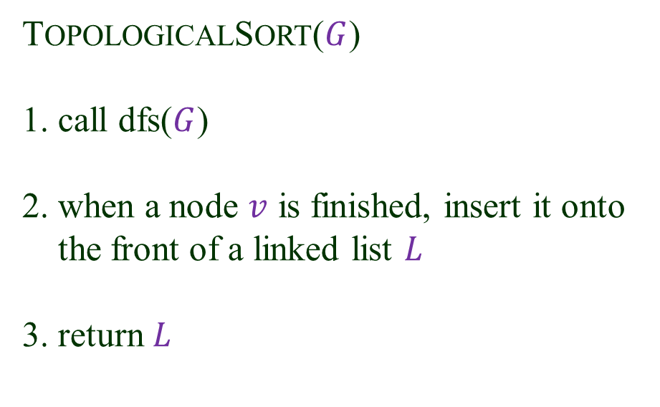
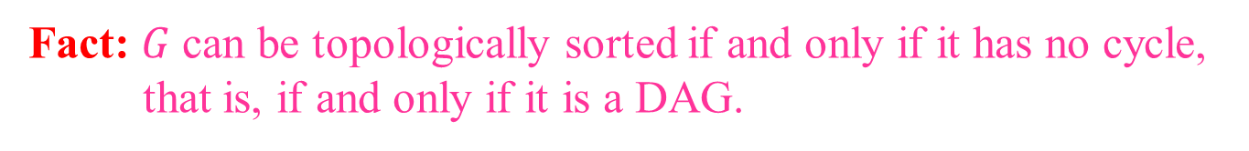



Topological Sort Algorithm
Fact: $G$can be topologically sorted if and only if it has no cycle,
that is, if and only if it is a DAG.
TOPOLOGICALSORT($G$)
1. call dfs($G$)
2. when a node $v$ is finished, insert it onto
the front of a linked list $L$
3. return $L$
$$// O(|V|+|E|)$$
$$// O(|V|)$$
Running time: $O(|V|+|E|).$

Slide 23





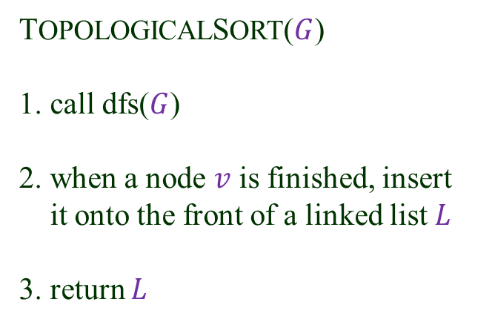









Execution
TOPOLOGICALSORT($G$)
1. call dfs($G$)
2. when a node $v$ is finished, insert
it onto the front of a linked list $L$
3. return $L$
$$a$$
$$b$$
$$c$$
$$d$$
$$e$$
$$f$$
$$g$$
$L$ (with the nodes in a topological order):
$$b$$
$$d$$
$$g$$
$$a$$
$$c$$
$$f$$
$$e$$

Slide 24







Correctness
At the moment a node $v$ is finished:
$$v$$
♦ All the nodes in the DFS subtree
rooted at $v$ must have just been
processed.
♦ They are the only nodes dependent
on $v$and thus have to appear after $v$.
♦ They are at the front of L.
♦ The algorithm inserts $v$ just before
them.
$$u$$
$$w$$
…
…
DFS subtree rooted at $v$

